Slide 1
Flip Flops

Slide 2
Sequential Circuits
Most digital systems like digital watches, digital phones, digital computers, digital traffic light controllers and so on require memory elements
Memory elements are digital circuits that can store and retrieve data in the form of 1's and 0's.
The output of the systems with memory depends not only on present inputs but also on what has happened in the past

Slide 3
Sequential Circuits
A flip flop is a circuit which has two stable states and thereby is capable of serving as 1 bit memory.
Types of flip flops:
SR flip flop
JK flip flop
Master slave JK flip flop
the Master-Slave Flip-Flop is basically a combination of two JK flip-flops connected together in a series configuration. Out of these, one acts as the “master” and the other as a “slave
T flip flop
D flip flop

Slide 4
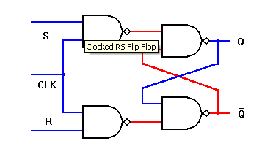
SR flip flop

Slide 5
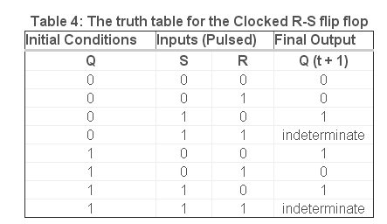

Slide 6
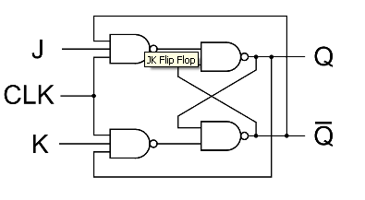
JK flip flop

Slide 7
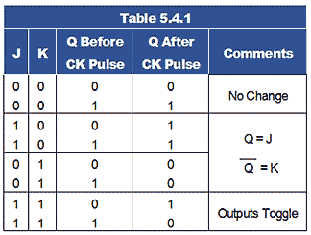

Slide 8
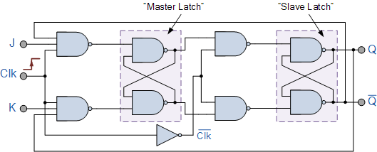

Slide 9
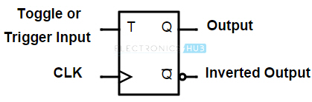
T flip flop

Slide 10
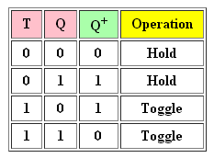

Slide 11
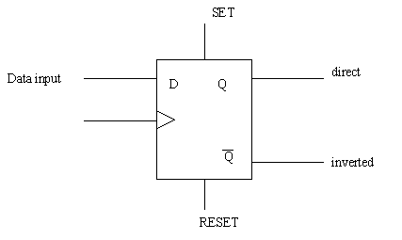
D flip flop

Slide 12
